Slide 1

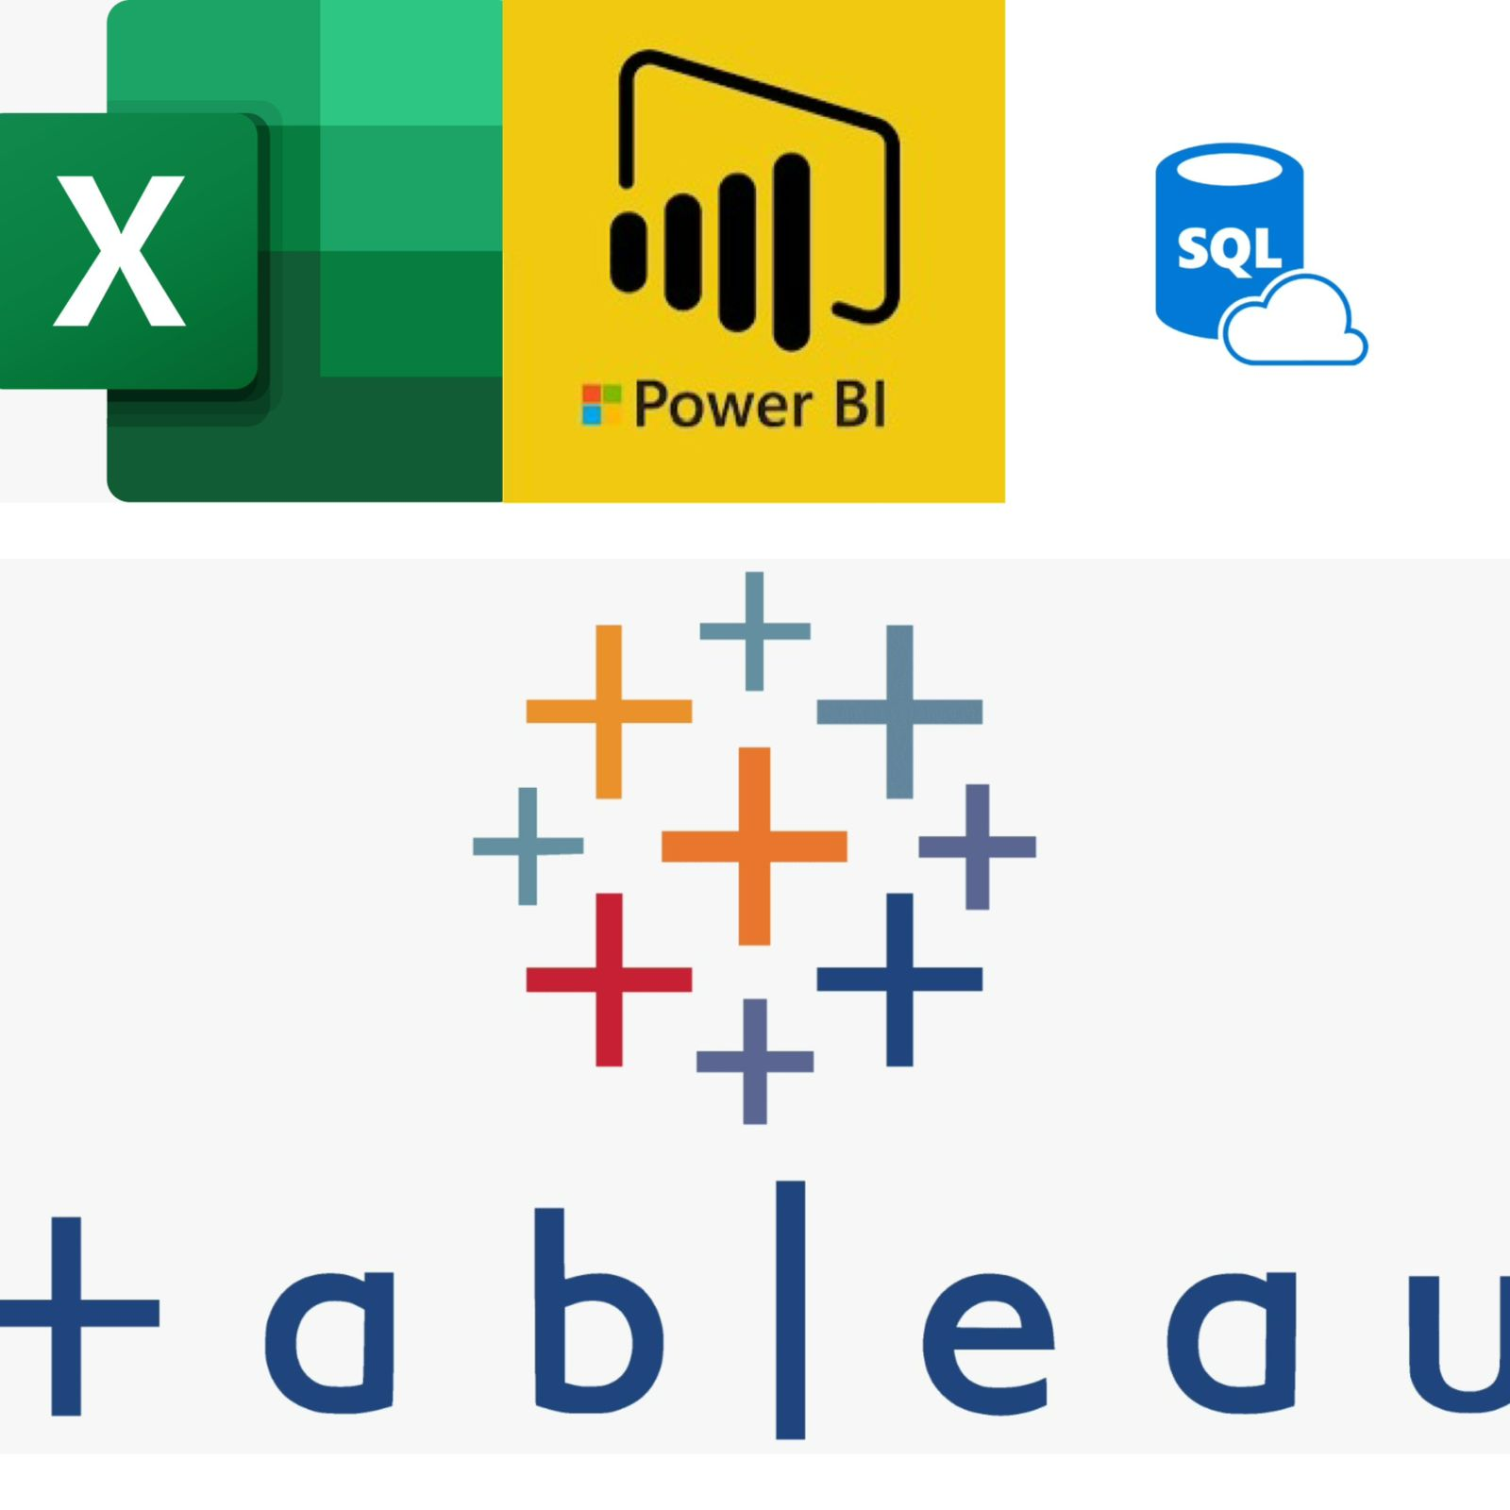
ADVENTURE WORKS
PROJECT PRESENTATION
Excel,Power Bi, Tableau, SQL
Prepared by group 1
17 January, 2026

Slide 2
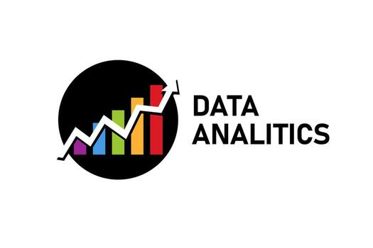
Agenda
Group Members
Background Project
Project Analysis
Project KPI Objectives
Excel , Power BI, Tableau Dashboard, SQL Script
Summary of Insights
Key Insights of Data Analytics
Conclusion
ADVENTURE WORKS

Slide 3




Team Members
Jayashree Rout
Gandharva Thotla
G.V.Murali Krishna
Shaikh Mohammad Imran

Slide 4



Team Members
HARINI KARANAM
MOHD. SAIF
ARPAN NAG

Slide 5

Background Project
Current scenario:
Adventure Works Cycles is a multinational bicycle manufacturer expanding markets by leveraging Mexico-based production, web sales, and targeting its best customers globally. In this project, we analyze overall sales and profit based on business requirements using Excel, Power BI, Tableau, and SQL. We have visualized raw data for the client and performed data modeling to identify regional and country-level growth trends, helping the company adapt sales strategies to maintain and increase its competitive edge.
ADVENTURE WORKS

Slide 6


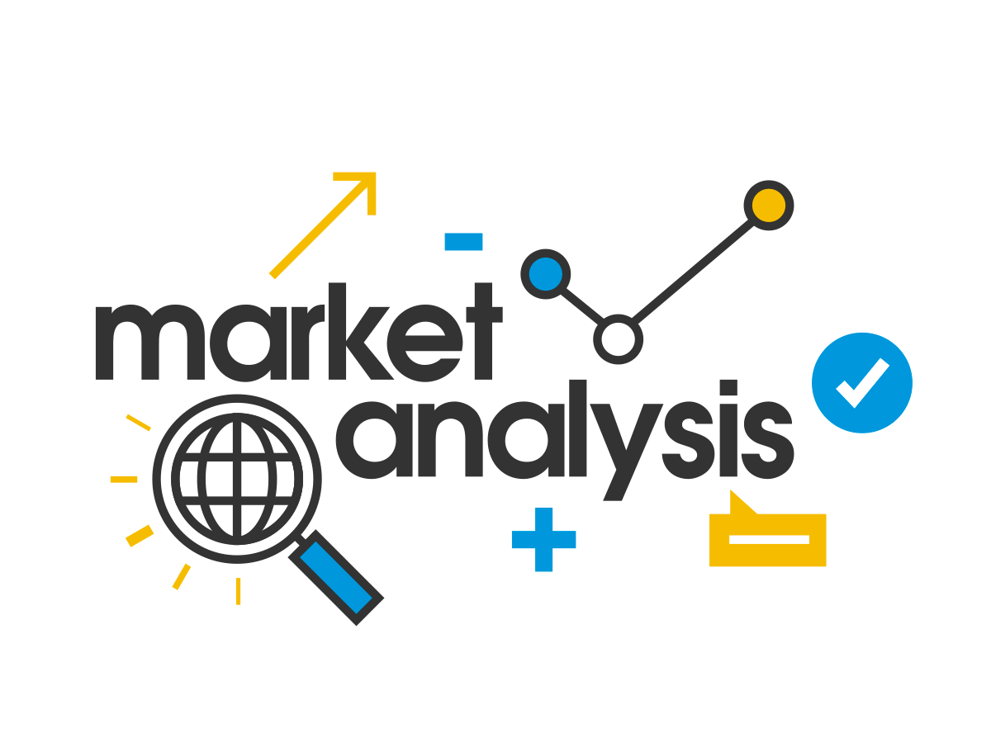



Project
Analysis
Current Sales Trends:
Our detailed analysis shows total sales of $31.71M across 6 countries, covering 504 products divided into 3 categories, with a total profit of $14.43M over 5 years.
Market Insights:
Mountain-200 Black (sizes 46 and 42) recorded the highest sales, while Racing Socks (Size L) had the lowest sales. Our analysis also shows that the United States generated the highest sales, whereas Canada had the lowest. Sales declined in 2014, while strong growth was observed in 2011 and 2013.
ADVENTURE WORKS
Feedback:
Based on the analysis, sales and profit show an upward trend year-wise , along with valuable country-level insights.

Slide 7
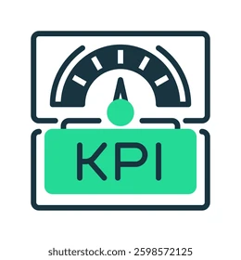



Project KPI Objectives
Analysis Phase
Year Wise Sales & Profit
Quarter Wise Sales
Country Wise Sales
Month Wise Sales
Total Customer Count
Top 10 Product Name
Distance Wise Customer Count
Region Wise Sales & Profit
Total Profit
Total Production Cost
Total Orders
Sales Revenue

Slide 8
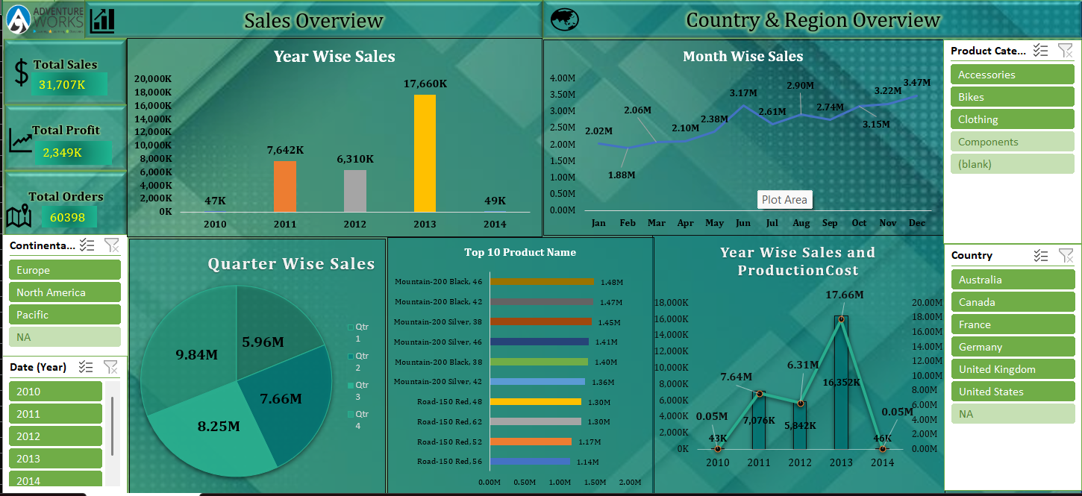
Excel Outcomes

Slide 9
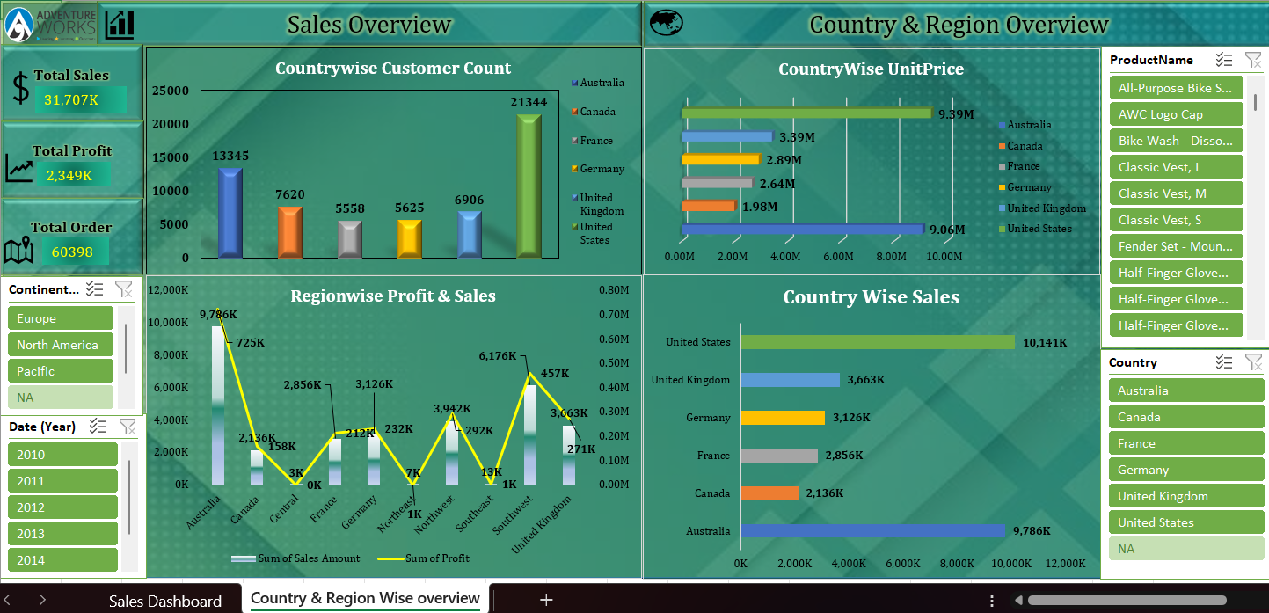
Excel Outcomes

Slide 10
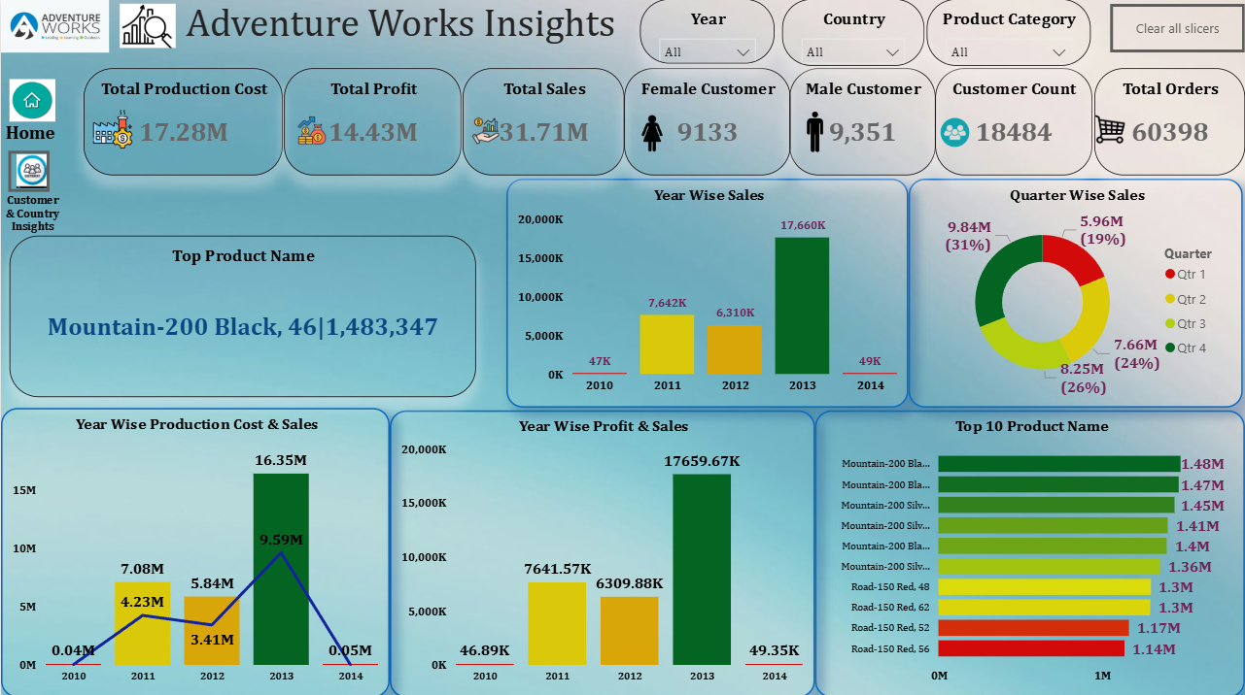
Power BI Outcomes

Slide 11
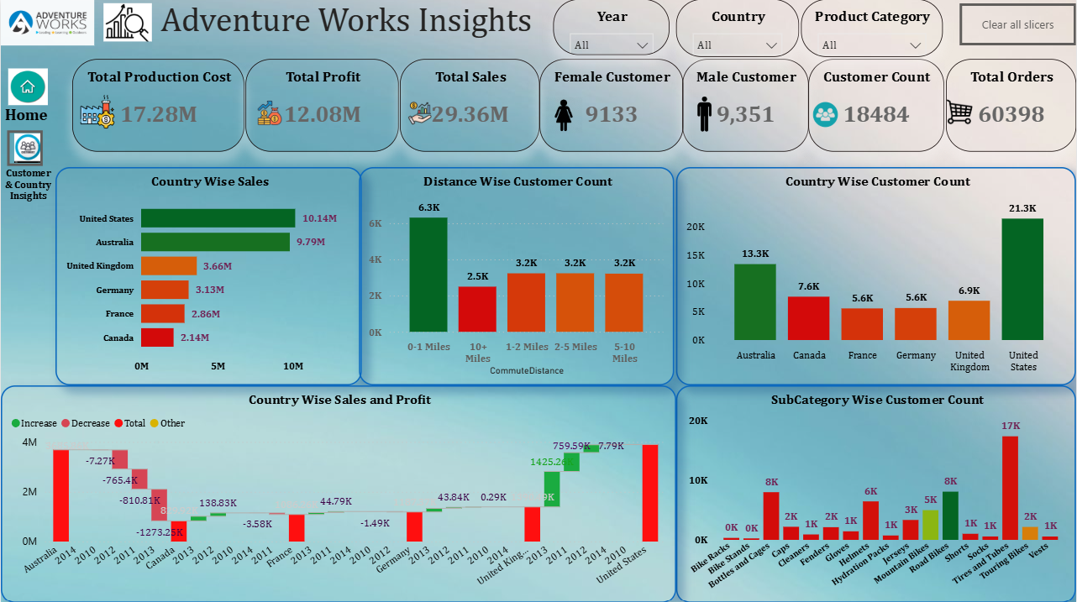
Power BI Outcomes

Slide 12
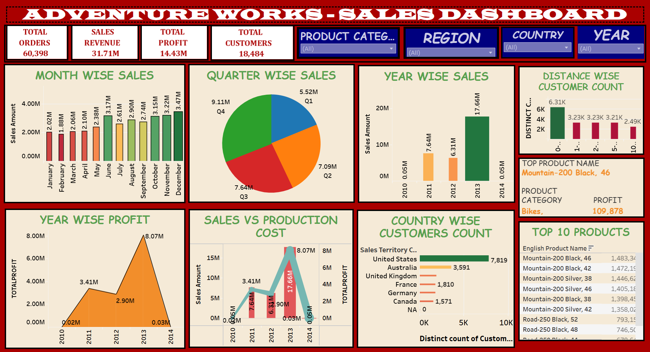
Tableau Outcomes

Slide 13
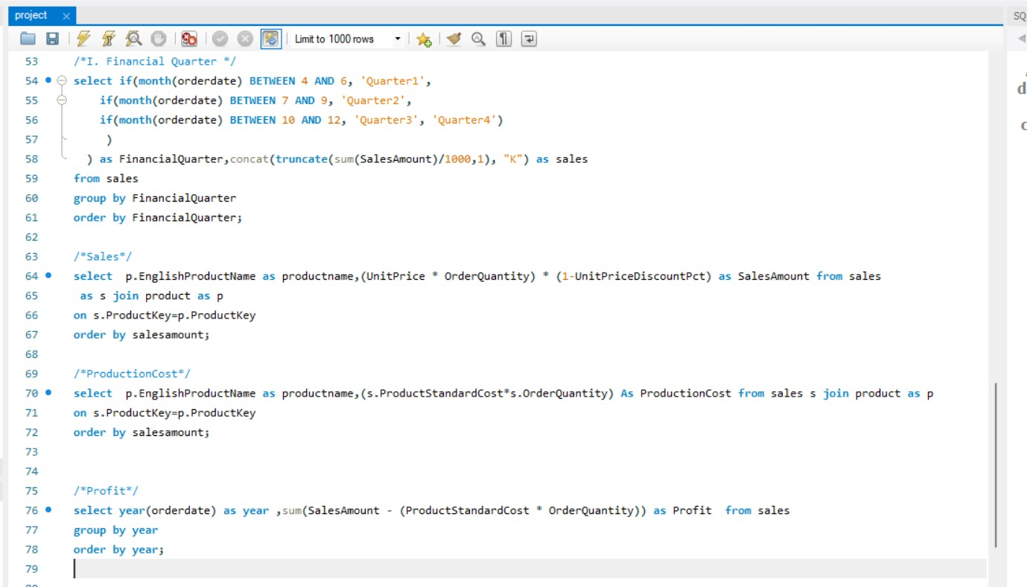
SQL Outcomes

Slide 14
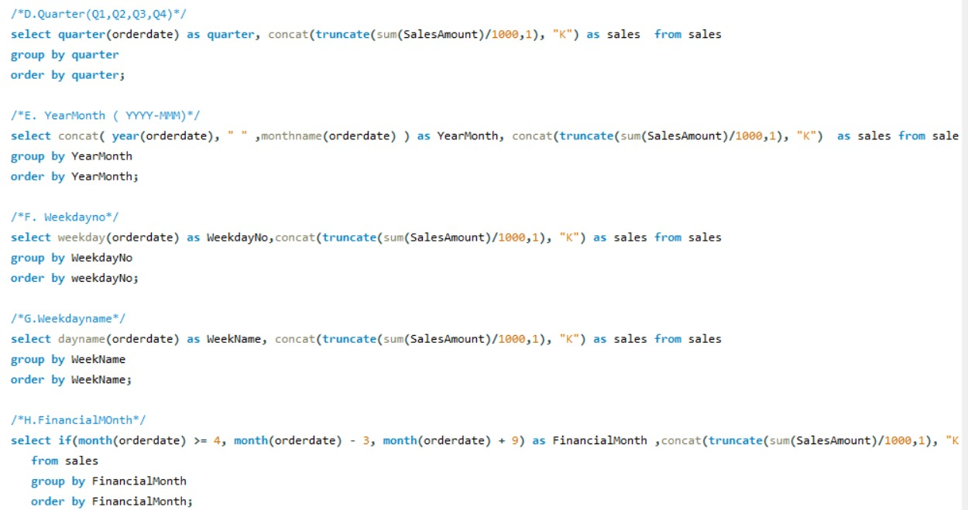
SQL Outcomes

Slide 15
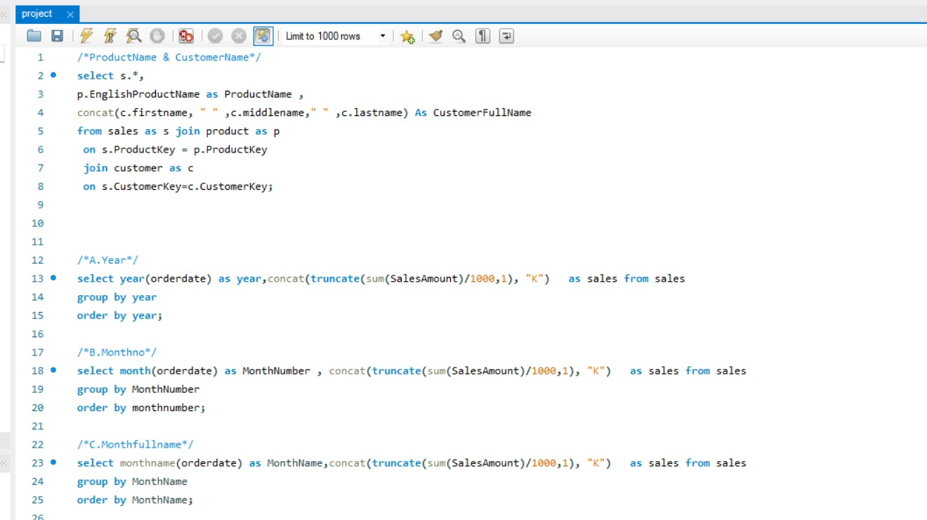
SQL Outcomes

Slide 16

Summary of Insights
Year Wise Sales & Profit : Monitoring the year wise sales and profit to seasonal trends and overall business health.
Quarter Wise Sales : Analysing the quarter wise as well so that performance can be improved.
Country & Region Wise Sales : Evaluate country wise sales to identify the country’s performance as well as the regional performance . This can guide to improve the marketing across region and country as well.
Top 10 Product Name : Focus on the top performing product so that Identifying top products helps prioritize inventory, optimize marketing, improve forecasting, guide pricing and development, focus sales, and reduce business risk.
ADVENTURE WORKS

Slide 17

Summary of Insights
Distance Wise Customer Count: Distance-wise customer analysis helps identify demand zones, optimize warehouses, reduce logistics costs, improve delivery routes, support regional marketing, enhance customer experience, and plan capacity efficiently.
Sales Revenue: Sales growth analysis measures performance, identifies opportunities, supports planning, guides investments, evaluates strategies, manages risks, and strengthens competitive positioning.
Country Wise Customer Count : Country-wise customer analysis identifies key markets, guides regional strategies, improves forecasting, optimizes pricing, allocates resources, and enhances customer targeting.
ADVENTURE WORKS

Slide 18


Key Insights for Data Analytics
Enhancing storytelling and dashboard design for stakeholders
ADVENTURE WORKS
This project can help us to build strong data cleaning, modelling, analysis skills. Gaining hands-on experience with business focused insights. Strengthening skills in excel, power bi, tableau, SQL. Enhancing dashboard design for stakeholders. Learning to convert data into actionable recommendation.

Slide 19






This project demonstrates how integrated analytics using Excel, Power BI, Tableau, and SQL uncovers sales trends, top products, and regional performance. The insights support data-driven decisions, optimize operations, enhance customer targeting, and help Adventure Works sustain growth, improve profitability, and maintain a competitive global position.
Conclusion

Slide 20

Thank You
From Group-1

